Slide 1

North Chapel Hill
Market Overview
November 6, 2020

Slide 2

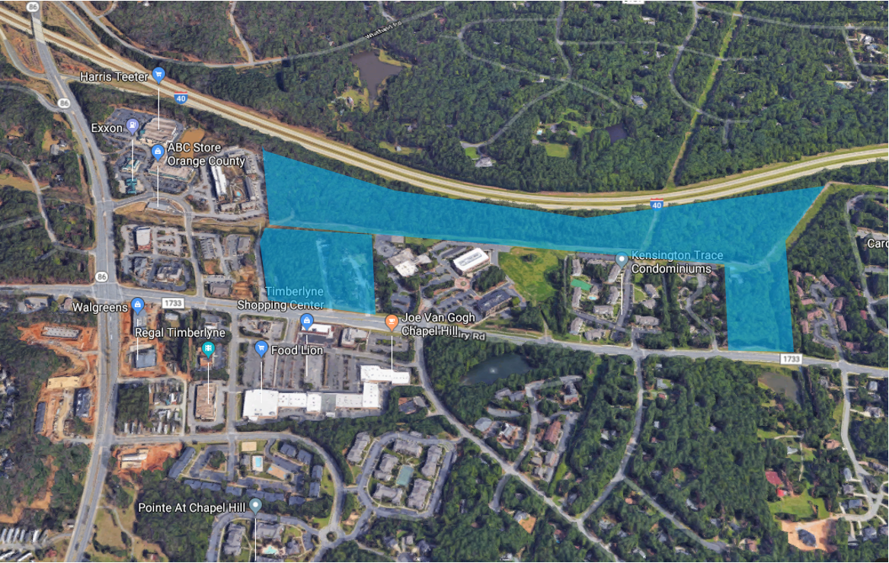
Chapel hill north site
45 (est. 30 usable) Acres listed at $15.1M ($335.5/acre ~ $500k/useable)
10 Acres previously under contract at $6.5M ($650k/acre)
45 Acres
10
Acres

Slide 3
Chapel hill north site
Total site estimated land value @ $19M or $345k/acre, @ $475k/useable
Master horizontal development previously est. at $5-7 M, now $8M @ $200k/useable
45 Acres
10
Acres

Slide 4
Feasible development type overview
Land Use | Market Values | Pad Ready Land Values Supported/ Unit/SF | Potential Density/ Acre | Land Values Supported/ Acre
Single-Family Homes | $500-800k | $50-100k | 2-3 | $100-300k
Townhomes/ Condominiums | $400-500k | $40-50k | 8-10 | $320-500k
Class A Rental Apartments (Excl. Student) | $1.50-$1.70 | $20-25k | 30-35 | $600-875k
Retail | $25-35 NNN | $35-40/SF | 5-15,000 | $200-600k *DNI Owner Occ.
Office | $25-30 FS | $35-40/SF | 20-25,000 | $700-1M
Lodging | $90-100 ADR | $20-25k | 50-75 | $1-1.875M

Slide 5
Feasible development
W/Market needs
Land Use | Land Values Supported/ Acre | Market Demand | Maximum Potential for Site
Single-Family Homes | $100-300k | High | Will not justify land value
Townhomes/ Condominiums | $320-500k | High | Does not justify developed land cost, but can be offset by higher values below
Class A Rental Apartments (Excl. Student) | $600-875k | High | Could be up to 600 units – likely not able to support structured parking, so up to 20 acres
Retail | $200-600k *DNI Owner Occ. | Low | Limited to under 20,000 SF, less than 2-3 acres
Office | $700-1M | Low | Limited to under 60,000 SF, less than 2-3 acres
Lodging | $1-1.875M | Low | Limited to one hotel @ 150 rooms, less than 2-3 acres

Slide 6
development cost comparison
Land Use | Prev. Cost Assumptions | 10/8/20 Concept Plan | Dev. Pad Land Value Change
Land Cost | $18M | $19M | +$1M
Horizontal Development Cost | $5-7M | $8M | +$1-3M
Total | $23-25M | $27M | +$2-4M

Slide 7
development program comparison
Land Use | Prev. Units/ SF | Prev. Dev. Pad Land Value | 10/8/20 Concept Plan | 10/8 Dev. Pad Land Value | Dev. Pad Land Value Change
Townhomes/ Condominiums | 220 | $8.8M | 137 | $5.48M | -$3.32M
Class A Rental Apartments (Excl. Student) | 400 | $10M | 240 | $6M | -$4M
Retail | 20,000 | $800k | 31,500 | $1.26M | +$460k
Office | 60,000 | $2.4M | 63,000 | $2.52M | +$120k
Lodging | 150 | $3M | 90 | $1.8M | -$1.2M
Park Space | - | $0 | - | $0 | -
Total |  | $25M |  | $17.06M | -$7.94M

Slide 8
Financial Feasibility gap
Land Use | Prev. Cost Assumptions | 10/8/20 Concept Plan
Total Cost | $23-25M | $27M
Dev. Pad Land Value | $25M | $17.06M
Dev. Margin (at 0% profit for horizontal developer) | $0-2M | -$10M

Slide 9
Financial Feasibility gap
Potential ways to close the $10M gap
  Town cover all of the $8M infrastructure and act as master horizontal developer
  Increase MF density, every additional market rate unit = $25k in land value. Additional 80 units = $2M
Affordable requirements – if the Town want to require a % affordable MF units this increased the financial gap. Every 80% AMI affordable unit = approximately $50k cost to developer

