Slide 1
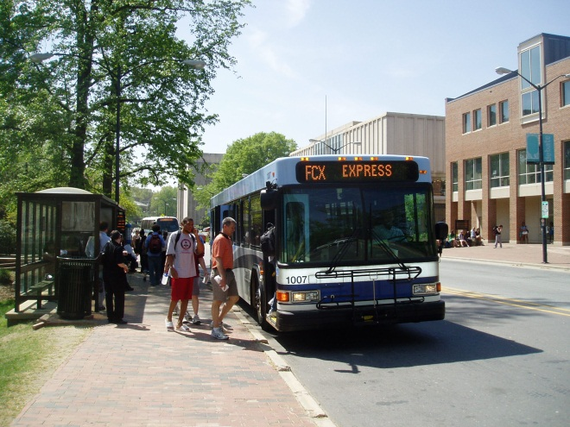
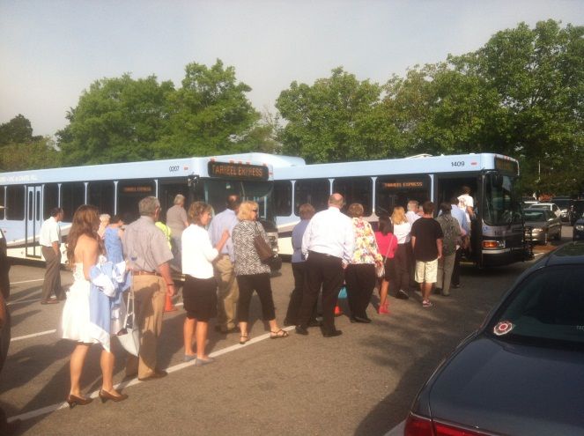
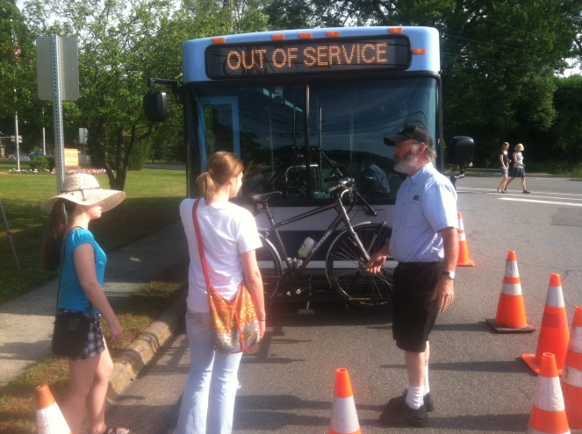
Chapel Hill Transit
FY2019-20 Budget Update
Transit Partners Committee
April 23, 2019

Slide 2
FY2019-20 Potential Priorities
Maintain/improve existing levels of service
Short Range Transit Plan
Electric bus fleet (3 buses ordered and in service, depending on delivery date)
North South Bus Rapid Transit (OC Transit Plan Funded)
  Finish 30% design and environmental
  Funding
Operator Recruitment and Retention (existing resources)
Jones Ferry Park and Ride Repair (grant funded)
Safety Upgrades to Entrance Gate (grant funded)
Bus Stop Improvement Project (grant funded)
  Solar Lighting and Small Solar Powered Real-time Signs
Solar Canopy Feasibility Study (grant funded)
Continue Art in Transit Collaboration (existing resrouces)
Notes:
Talk about changes in federal landscape and new transpo bill

Slide 3
Current Status
Staff have begun work internally and with the Town’s Business Management Department (BMD) towards developing our FY19-20 budget proposal.
Town of Chapel Hill Budget Calendar
  May 1 – Manager’s Recommended Budget
  May 8 – Public Hearing on Recommended Budget
  May 15 – Budget Work Session
  June 5 – Budget Work Session
  June 12 – Proposed Adoption Date for FY2019-2020

Slide 4
FY2019-20 Potential Budget Adjustments
SMAP – State Funding Down ~$686K
  Potential for restoration and offset with State Match/CMAQ
Orange County Transit Plan (cost of existing service funding down $~150K)
  Looking at options
Fuel, pay and health insurance
Capital – State match for bus purchases and grants
  Fleet size adjusted from 99 to 93
  Only had to debt-finance 14 buses (at lower than expected rates)
  Federal/State grants for Demand Response Vehicles
Slight increase in FTA 5307 and 5339 funds
Advertising Revenue
Notes:
Talk about changes in federal landscape and new transpo bill

Slide 5
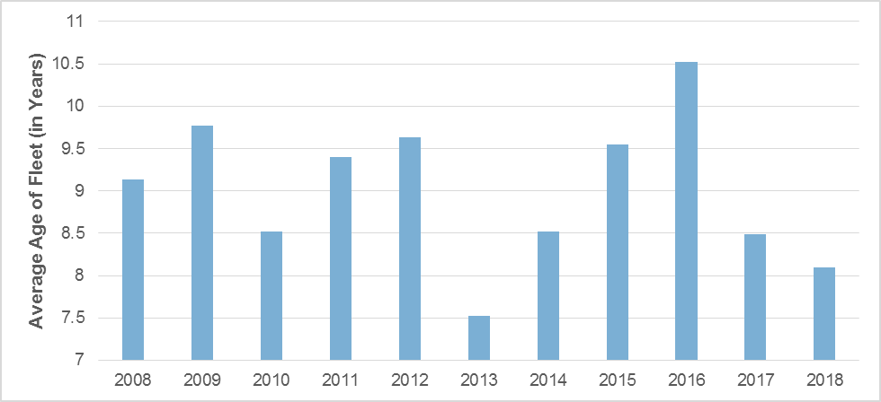
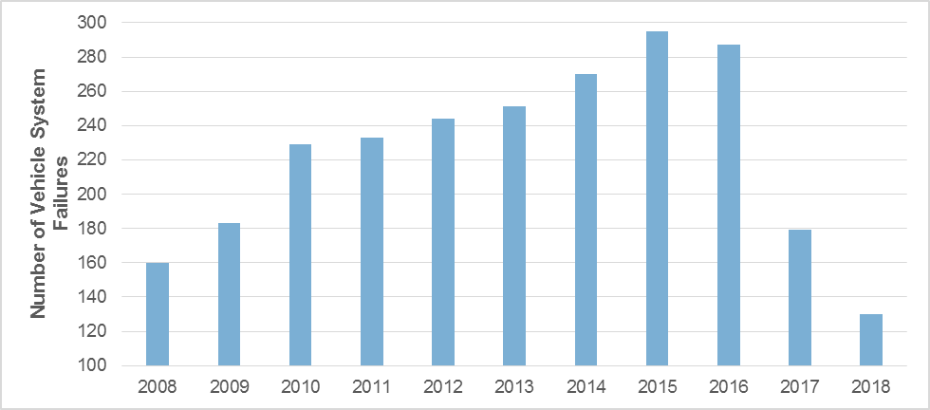
Capital/Maintenance Trends
CHT Average Bus Fleet Age
CHT Number of Bus Failures
Last infusion of federal grant funds

Slide 6
Capital Plan FY16-28
Replacement of 49 fixed route buses by FY20 (39 of 42 delivered/ordered for FY19)
  16 Fixed Route buses replaced through FY17
  6 Fixed Route buses delivered in May 2018
  6 Fixed Route buses delivered in February 2019
  8 Fixed Route buses on order for delivery in August 2019 and December 2020
  3 Fixed Route buses pending order with Electric bus grant
  2 Fixed Route buses with existing Capital Reserve Funds (FY20 delivery)
Replacement of 20 Demand Response vehicles by FY20 (20 of 20 delivered/ordered by FY19)
  7 Demand Response vehicles delivered in FY18
  7 Demand Response vehicles on order grant funds (FY19 delivery)
  6 Demand Response vehicles w/ Capital Reserve and state match (FY20 delivery)
Capital Plan Savings
  Fleet size from 99 to 93 ($2.5M+)
  Only debt financed 14 buses (at planned cost of 12)
  Demand response fleet replaced w/ grant funds ($1.5M)
  Orange County Transit Plan funds for 8 buses (3 planned - $2.3M)
  Eubanks Park and Ride turnaround repaired by private developer ($750K+)
  State match and grant funds have offset Partner match needs ($840K)

Slide 7
Partner Contribution Estimates for FY20
Staff has submitted a preliminary budget (totaling $24.8M) to the Business Management Department.
  These figures below are shared in the interest of full disclosure for planning purposes, but are tentative and will be refined.
  Budget still needs to go through Town Manager’s recommendation to Council, and Council approval.
    Includes debt service payments, but no additional capital from partners.
Approx. Total Share per Partner | FY18-19 Contribution | FY19-20 Contribution* | FY19-20* Difference | FY20 Projection
Chapel Hill | $ 5,388,052.00 | $ 5,491,174.00 | $ 103,122.00 | $ 5,682,000.00
UNC | $ 8,575,736.00 | $ 8,730,231.00 | $ 154,495.00 | $ 9,438,000.00
Carrboro | $ 1,808,945.00 | $ 1,843,566.00 | $ 34,621.00 | $ 1,919,000.00
Total Local Funding | $ 15,772,733.00 | $ 16,064,971.00 | $ 301,876.00 | $ 17,039,000.00

Slide 8
Potential FY20 Service Considerations
Staff has identified some potential service improvements/adjustments for FY20 that are consistent with the Short Range Transit Plan and can be funded with Orange County Transit Plan funds, State CMAQ funds and minor service adjustments (without impacting our ability to implement the Short Range Transit Plan):
A Limited – Remove from service due to lower ridership demand (several multifamily developments on Hillsborough Street are under construction or being redeveloped).
NS – Designed to meet increased demand from multifamily developments in the corridor during morning peak. This will improvement will add trips between 7:00 AM – 9:00 AM between Eubanks Park and Ride and UNC Hospital.

Slide 9
Potential FY 19-20 Service Considerations
CM/CW – Designed to improve ridership potential by providing bi-directional service on both routes from 7:00 PM – 9:30 PM.
HS – Designed to improve ridership potential by extending the route to serve Downtown, University, UNC Hospital, ACC and Culbreth Road. The route will operate weekdays from 6:00 AM to around 7:00 PM, providing hourly service.
D – Designed to eliminate overcrowding and improve frequency in a high-demand corridor. The Route will terminate at UNC Hospital to allow for additional trips serving the University, UNC Hospital, Franklin Street, Elliott Road and Blue Hill District between 6:30 AM to 9:30 PM. The route will no longer serve Culbreth Road and Smith Level Road, which will be served by the extension of the HS route.

