Slide 1
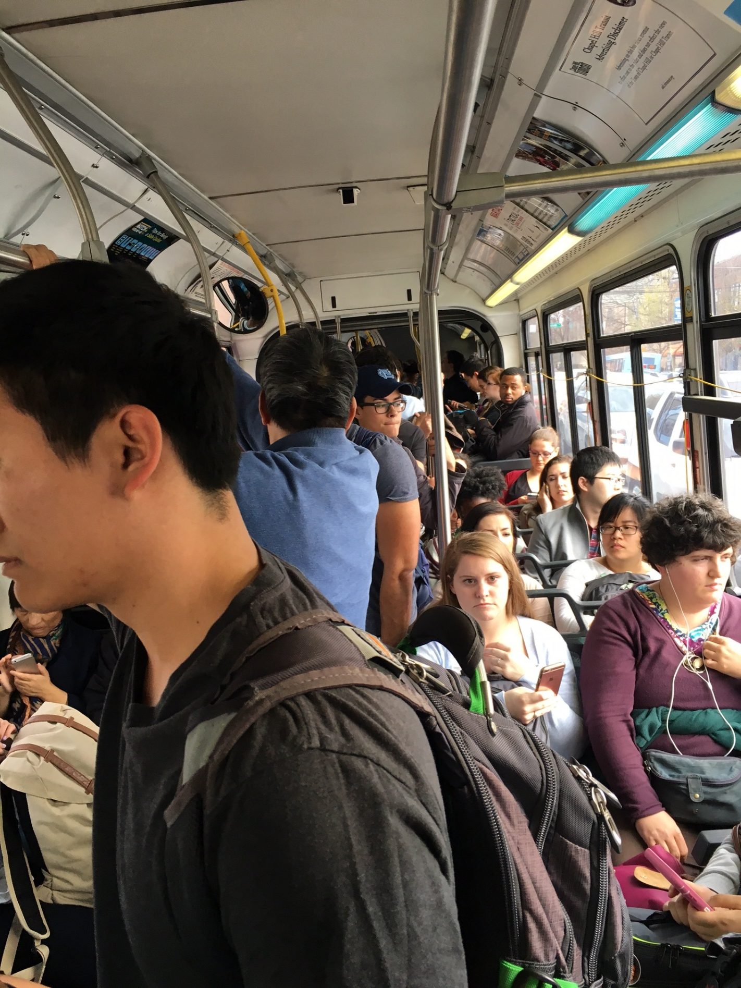
Chapel Hill Transit
FY2017-18 Service Plan Update
Transit Partners Committee
May 23, 2017

Slide 2
“New” Service Implemented From 2012 Plan
Route | Improvement | Hours | Buses
A | Improve service on Hillsborough Street during peak (AM) | 2.80 | 1
CM | Extend Evening Trips Year Round | 1.25
CW | Extend Evening Trips Year Round | 2.25
D | Extend Evening Trips Year Round | 1.37
D | Extend 7:17am trip to begin in Carrboro | 0.69
F | Add Trips 7:38p (Old Fayetteville) 8:45p (Colony Woods) | 2.14
HS | Additional trips to route with routing improvement | 2.15
J | Extend Evening Trips Year Round | 5.28 | 1
J | Improve peak hour capacity issues (AM & PM) | 2.08 | 1
NS | Improve mid-day service (10am-2pm) | 5.74 | 1
CM | Additional Saturday Service | 6.42 | 1
CW | Additional Saturday Service | 3.88
JN | Add Trip 9:10a (Estes Park) | 0.74
SAT | Extend service to 6:00p on all routes (D, FG) | 2.38

Slide 3
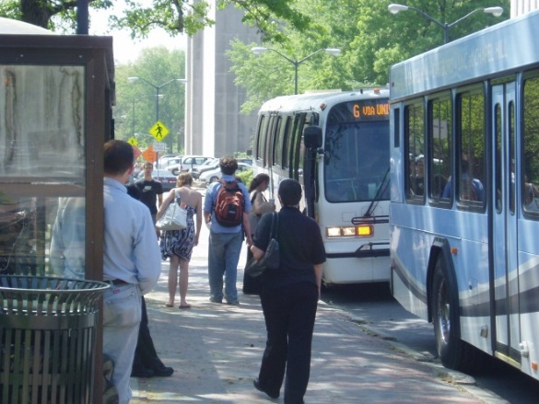
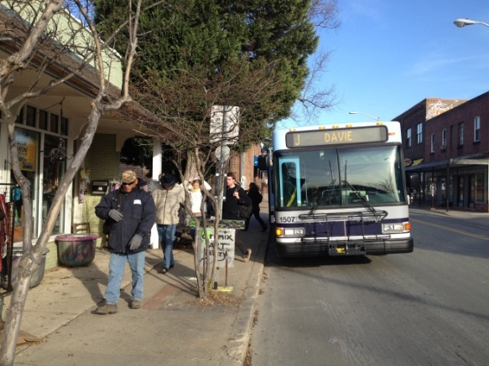
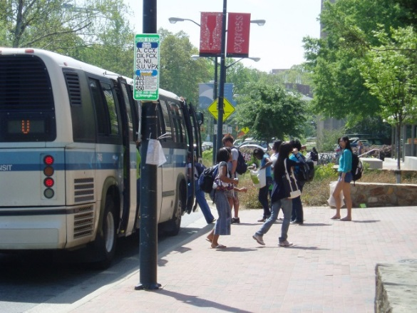
OC Bus and Rail Investment Plan FY2017-18
  Staff recommended investments: ~$1.8M (~$2.0M will be available):
    ~$755K for cost of existing services
    ~$645K for services started with Plan funds
    ~$200K for service expansion
    An additional $300K available for service improvements
  North South Study for FY2017-18 = $1.5M

Slide 4
Potential FY2017-18 Service Adjustments
Staff Recommended Priorities
DX – Discontinue service due to low demand and reallocate hours to other adjustments. Issue press release and place information on bus stops this week related to potential route discontinuation. Public comment period through May 25th.
D – Adjustments to peak hour service to improve capacity issues (funded by DX hours)
CCX – Additional PM trips to better accommodate UNC Hospitals shift times (6:45 P.M. and 7:25 P.M.)
Senior Shuttle – Updates to current routing and schedule to improve on-time performance. Discontinue Botanical Garden stop.
Notes:
DX—note that based on the Public Participation Plan (revised 11/8/11) this change does not result in a “Major Service Change”. The route is duplicated by the D route and does not result in any segment being eliminated.

Slide 5
Potential FY2017-18 Service Adjustments
Staff Recommended Priorities
HU – Adjustment to current route to better serve Baity Hill student housing and Mason Farm Road (University funded route)
V – Deviate existing route to serve St. Thomas More
  Modify 7:30 A.M. trip from W. Barbee Chapel at Harris Teeter and 7:40 A.M. trip from Southern Village;
  Start afternoon peak service at W. Barbee Chapel at Harris Teeter (2:59 P.M.) and modify 2:50 P.M. trip from Southern Village
Notes:
Number of customers effected from Southern Village and Meadowmont with these buses deviating. Meadowmont = 10 average; Southern Village = 5 average

Slide 6
Potential FY2017-18 Service Expansion
In Manager’s Recommended Budget
NS – Evening service expansion to Southern Village from 7:30 p.m. to 10:50 p.m. (est. 840 hours)
CW – Peak hour expansion of existing route (est. 838 hours)
V Saturday – Create new Saturday Route from Meadowmont via Downtown to Southern Village (est. 540 Hours)
Notes:
NS increased to 840 based on adding additional bus with the increased length of trip to SV. This will allow 40 minute service to both P&Rs in later evening.

Slide 7
Potential FY2017-18 Service Expansion
If More OCBRIP Funding is Available
Expansion of Saturday Service – begin all routes around 8 AM, extend all routes to 7 PM (est. 400 hours)
T – extend route to 15/501 & Sage Road (est. 2,000 hours)
G – improve peak hour service (est. 1,500 hours)
Expand Sunday service to match Saturday service levels (est. 3,500 hours)
Additional EZ Rider Sunday service (est. 450 hours)

Slide 8
Questions/Feedback
Brian M Litchfield
Director
Chapel Hill Transit
(919) 969-4908
blitchfield@townofchapelhill.org
www.chtransit.org
www.facebook.com/chtransit
www.twitter.com/chtransit
Customer Service Line: (919) 485-7433

