Slide 1




Orange County Street Outreach and Harm Reduction Program
Town of Chapel Hill Reimagining Community Safety Task Force
March 29, 2021

Slide 2
Our community has demonstrated need for street outreach
Orange County Sequential Intercept Mapping (SIM)
Facilitated by N.C. Department of Health and Human Services
April 2019
Homeless System Gaps Analysis
Expansion of Pre-Arrest Diversion/Deflection (OC-PAD)
COVID-19 community response
Focus on re-imagining public safety

Slide 3
SOHRAD connects people living unsheltered with housing and services
Funded by Emergency Solutions Grant CARES Act (ESG-CV)
Began operation October 2020
12 months of funding end September 2021
Program model include 3 FTEs
Positions | # Staff | Location
Harm Reduction Deflection Coordinator | 1 | OC Criminal Justice Resource Department
Street Outreach Peer Navigators | 2 | OC Housing & Community Development with OC Partnership to End Homelessness

Slide 4
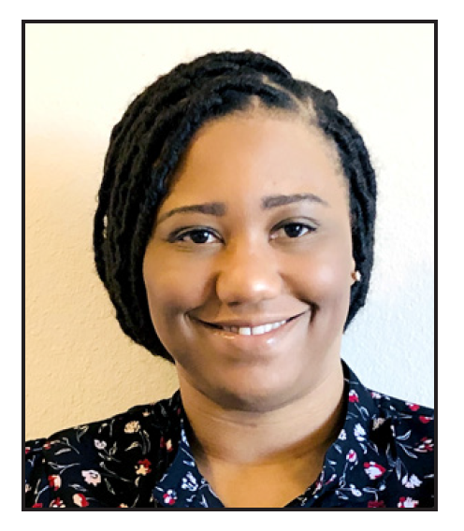
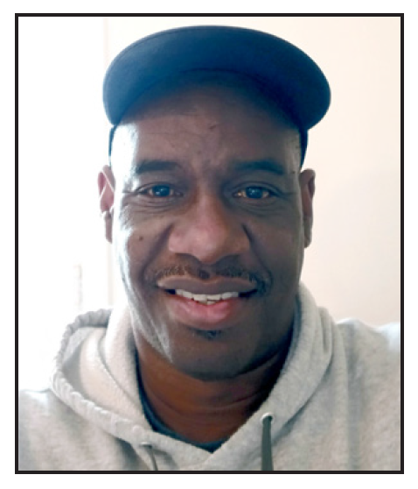
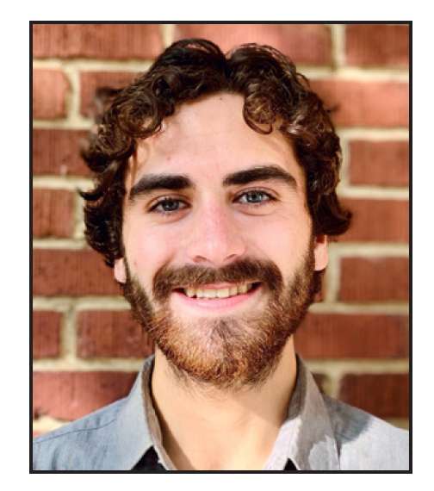
Meet the team
Tiffany Hall Harm Reduction Clinical Coordinator
Donald Hardin Peer Support Navigator
Brandon Morande
Peer Support Navigator

Slide 5
SOHRAD uses a trauma-informed, relationship-based model
Ongoing engagement and harm reduction
People living unsheltered, many behavioral health issues
Visits to campsites, hospitals, jail, streets
Connections to housing, food, medical care, treatment services, transportation and employment
Therapeutic assessment, case plans, case management
Referral contact for community members, law enforcement, and businesses
Reduce policing and justice involvement

Slide 6
SOHRAD work and accomplishments
Served over 130 people since October 2020
21 people exited to permanent housing
22 people connected to emergency housing
80 people connected to services like tents and sleeping bags, food, transportation
16 people living unsheltered vaccinated for COVID-19
Vaccination work continuing
Over 20 law enforcement deflections

Slide 7
SOHRAD is here to help
SOHRAD Program Phone: 919-886-3351
SOHRAD Program Email: sohrad@orangecountync.gov
Monday-Friday 9am-11pm
Saturday 2pm-11pm
Welfare checks
Connections to housing and services
Case management and peer support
Harm reduction outreach
Law enforcement deflection

Slide 8
SOHRAD has several sustainability and program needs to address
Program funding starting Fall 2021
$237,015 annually
Downtown office space
Street Outreach one of several gaps to fill to end homelessness
Overlap with Behavioral Health Task Force Priorities
Crisis/Diversion Center
Day Center with integrated services
Increased behavioral health services

Slide 9
Contact SOHRAD team or management to talk further
SOHRAD Program Phone: 919-886-3351
SOHRAD Program Email: sohrad@orangecountync.gov
Caitlin Fenhagen, Criminal Justice Resource Director
919-245-2303
cfenhagen@orangecountync.gov
Emila Sutton, Housing and Community Development Director
919-245-2492
esutton@orangecountync.gov
Corey Root, Homeless Programs Manager
919-245-2496
croot@orangecountync.gov

