Slide 1
PUBLIC HEARING: Manager’s Recommended Budget FY2019-20
Notes:
Introduction:
We are here this evening for the Public Hearing on the Manager’s Recommended Budget for FY 2019-20.
My presentation is 14 slides and should last about 10 minutes.
At the end of the presentation, Council may open the public hearing to receive comments from the public on the recommended FY 20 Budget.

Slide 2
Recommended Budget Highlights
Manager’s Recommended Budget presented to Council on May 1st
https://www.townofchapelhill.org/town-hall/departments-services/business-management/budget/2019-20-recommended-budget
$113,030,494 budget for all funds (3.7% increase from FY19)
No Property Tax Increase for General Fund or Transit Fund
1.6 Cent Property Tax Increase for Debt Service Fund:
Support debt service for $10 million Affordable Housing Bond (1 cent)
Support debt service for General Obligation Bonds (0.6 cent)
Notes:
Manager’s Recommended Budget was presented to Council on May 1st. Tonight’s presentation is a summary of that presentation.
The FY 2019-20 Manager’s Recommended Budget Highlights:
$113,030,494 total for all funds (3.7% increase from FY 2019 budget)
$68,448,000 for General Fund
No property tax increase for General Fund or Transit Fund
1.6 cent property tax increase to support debt service for the $10 million Affordable Housing Bonds & debt for MSC, Streets, Wallace Deck & Elliott Rd Ext.
The Town’s Budget is an extension of the Town’s mission and the Council’s strategic goals and in many ways reflects the values of our organization and our community; making stronger connections between Council goals and the Town’s operating budget is a major goal of this year’s budget process
No change in core service levels

Slide 3
Property Tax Rates

Slide 4
Town Mission and Council’s Goals
Our Mission. Learning, serving, and working together to build a community where people thrive.
Council’s Strategic Goals
Connected Community
Economic & Financial Sustainability
Safe Community
Affordable Housing
Vibrant & Inclusive Community
Environmental Stewardship
Collaborative & Innovative Organization
Notes:
The Town’s Budget is an extension of the Town’s mission and the Council’s strategic goals and in many ways reflects the values of our organization and our community.
It begins with the mission of the Town, which are further fleshed out through the Council’s strategic goals of a Connected Community, Economic & Financial Sustainability, a Safe Community, Affordable Housing, a Vibrant & Inclusive Community, Environmental Stewardship and Collaborative & Innovative Organization. As you will see in our budget, many of of investments are directly aligned with these goals.

Slide 5
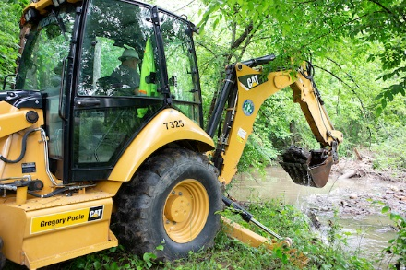
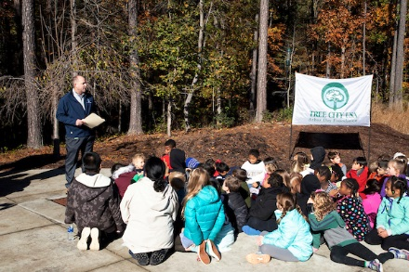
Recommended Budget Highlights
Environmental Sustainability
$315,000 for Coal Ash Remediation
$50,000 to develop a Climate Action Plan
Debt service payments to complete Stormwater
bond projects
$100,000 for Urban Design position
No Change in Core Service Levels
Notes:
Here are a few of the budget drivers for this year’s increase.
SW Debt →$2.7 million general obligations issued in FY 2018 and $3.2 million general obligations proposed issuance in FY 2020
$515,000 total increase in retirement contribution 7.75% → 8.95% (1.2% increase) all funds
$371,000 total general fund
$144,000 other funds
$214,580 total increase in retirement contribution originally anticipated 7.75% → 8.25% (0.5% increase) all funds
$154,580 total general fund
$60,000 other funds

Slide 6
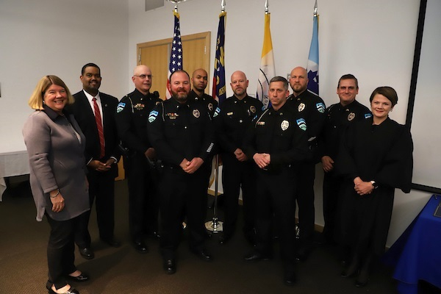
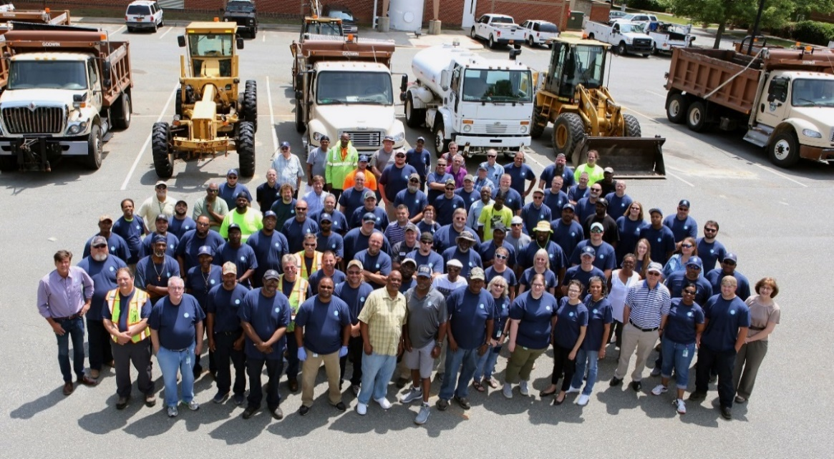
Recommended Budget Highlights
Personnel
3% of Market Pay Raise ($1,401,851)
Living Wage Adjustment ($47,915)
4.9% Medical Insurance Increase ($358,301)
1.2% Retirement System Increase ($515,000)
Sworn Police Officer Pay Adjustments to
recruit and retain officers ($200,000)
Comprehensive Classification and
Compensation Study ($100,000)
Notes:
75% of Town’s core expenses are employee related because we are a service organization. In order to maintain an excellent workforce to provide excellent services we must recruit and retain excellent employees – to do this the budget includes a 3% of market pay adjustment.
$1,401,851 all funds ; $1,007,687 general fund only
Maintain compliance with Orange County Living Wage standards ($13.70 -> $14.25 w/o health benefits & $12.20 -> $12.75 w/ health benefits.
Preliminary rate increase from BCBS of 4.9% (market trending at 6.2% increase)
$358,301 all funds ; $247,190 general fund only
The LGERS is increasing the employer contribution rate from 7.75% to 8.95% for general employees and from 8.5% to 9.7% for LEO

Slide 7
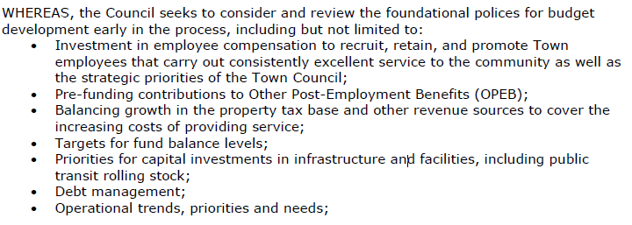
Budget Resolution 2018-06-13/R-5.1
Framework for the FY 2019-20 Manager’s Recommended Budget is centered around budget resolution 2018-06-13/R-5.1:
Notes:
The FY 2019-20 Manager’s Recommended Budget was developed using the budget resolution (2018-06-13/R-5.1) as a framework around which the components are centered upon.
Over the next several slides, we will walk you through each of the foundational policies for budget development and the components of the budget that make up each of those areas.

Slide 8
Budget Resolution Highlights
Investment in employee compensation
Other Post-Employment Benefit pre-funding contributions
Balancing growth in the property tax base to cover increasing expenditures
Fund balance reserve target
Capital investments
Debt management
Operational trends, priorities and needs

Slide 9
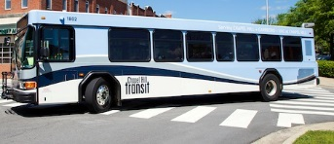
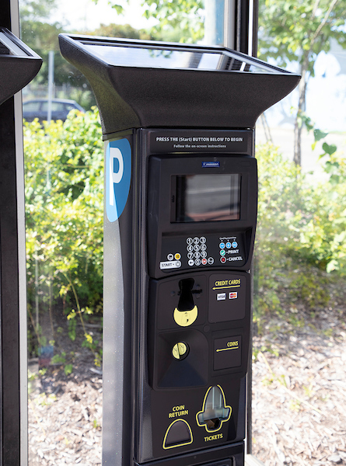
Enterprise Fund Summary
STORMWATER FUND:
$2.82 per ERU recommended fee increase to issue $3.2
million GO bonds: Lake Ellen Flood Storage Project, Red
Bud Flood Storage Project, Booker Creek Road Project
TRANSIT FUND:
No recommended tax increase; No proposed use of fund balance
$686,000 potential decrease in State Maintenance Aid Program funds
$1.3 million increase from Orange County Transit Plan for bus replacements
PARKING FUND:
Proposed use of fund balance of $233,861 to balance budget
No proposed parking fee increases
Will review rate structure and hours in FY 2020
HOUSING FUND:
Less fund balance needed to balance as HUD contributions and
rent increases
Notes:
Stormwater Fund
$10 average annual bill increase (10,790 bills out of 14,882 (72% of bills) have 2-4 ERUs (increase between $5.64-$11.28)

Slide 10
Pending Budget Considerations
Potential amendments not included in Manager’s Recommended Budget:
Downtown Partnership Executive Director $ 10,000
Food Council $ 29,110
Community Home Trust $ 5,370
Project to End Homelessness $ 17,958
$ 62,438
Recommendation will be made for these items plus anything that arises from tonight’s public hearing at the May 15th budget worksession

Slide 11
5-Year Budget Plan
5-year long-range plan to accomplish:
Environmental resiliency
Connections between strategic work plans to budget program expansions
Expansion of building maintenance and street paving programs
Restoration of pay-go capital and vehicle replacement programs
Sustainability of Town’s enterprise funds
Conversations with Council and community to begin Fall 2019

Slide 12
Next Steps
May 1 Presentation of Manager’s Recommended Budget
May 8 Public Hearing
7:00 p.m. Council Chamber
May 15 Budget Worksession
6:30 p.m. Chapel Hill Public Library
June 5 Budget Worksession
6:30 p.m. Chapel Hill Public Library
June 12 Proposed Budget Adoption
7:00 p.m. Council Chamber
Notes:
Here today for the Public Hearing.
Next steps:
May 15th – budget worksession
June 5th – will be a budget worksession if necessary; scheduled to follow-up on last conversation focused on strategic work plans
June 12th – proposed adoption of the FY 2019-20 budget

Slide 13
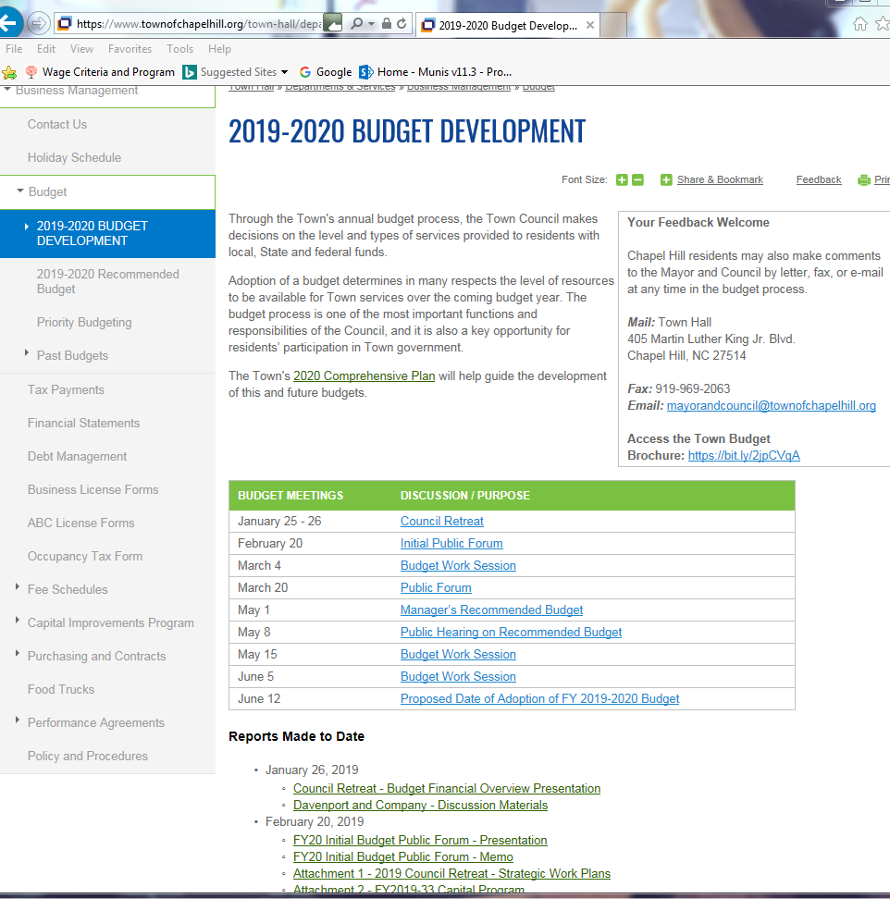
Budget Resources
Manager’s Recommended Budget Notebook
Budget Development Page on website:
https://www.townofchapelhill.org/town-hall/departments-services/business-management/budget/2019-2020-budget-development

Slide 14
Manager’s Recommended FY20 Budget
Council may open up the
public hearing to receive
comments from the public
on the FY20 budget
https://www.townofchapelhill.org/town-hall/departments-services/business-management/budget/2019-2020-budget-development

