Slide 1
BUDGET WORK SESSION : Manager’s Recommended Budget FY2019-20
Notes:
Introduction:
We are here this evening for the 1st Budget Work Session after the presentation of the Manager’s Recommended Budget
My presentation is 7 slides and last about 5-10 minutes.
We have three topics lined up for tonight’s meeting related to the FY 2020 budget
Orange County tax assessment
Coal Ash Remediation efforts
Transit Fund budget update

Slide 2
Recommended Budget Highlights
Manager’s Recommended Budget presented to Council on May 1st
https://www.townofchapelhill.org/town-hall/departments-services/business-management/budget/2019-20-recommended-budget
Opened public hearing for public feedback on the budget on May 8th
No Property Tax Increase for General Fund or Transit Fund
1.6 Cent Property Tax Increase for Debt Service Fund:
Support debt service for $10 million Affordable Housing Bond (1 cent)
Support debt service for General Obligation Bonds (0.6 cent)
Notes:
Manager’s Recommended Budget was presented to Council on May 1st.
Public hearing for public feedback on the budget on May 8th.
The FY 2019-20 Manager’s Recommended Budget Highlights:
$113,030,494 total for all funds (3.7% increase from FY 2019 budget)
$68,448,000 for General Fund
No property tax increase for General Fund or Transit Fund
1.6 cent property tax increase to support debt service for the $10 million Affordable Housing Bonds & debt for MSC, Streets, Wallace Deck & Elliott Rd Ext.
The Town’s Budget is an extension of the Town’s mission and the Council’s strategic goals and in many ways reflects the values of our organization and our community; making stronger connections between Council goals and the Town’s operating budget is a major goal of this year’s budget process
No change in core service levels

Slide 3
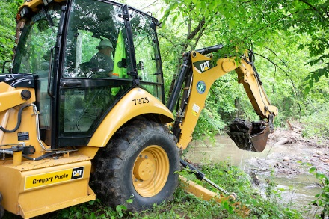
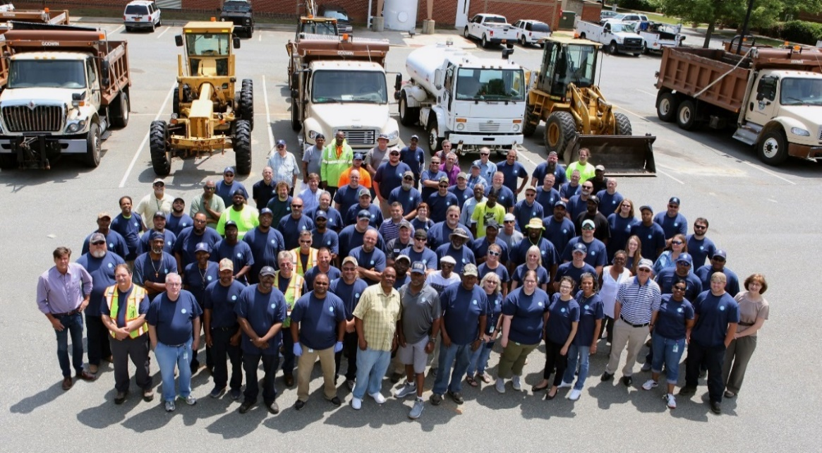
Recommended Budget Highlights
Environmental Sustainability
$315,000 for Coal Ash Remediation
$50,000 to develop a Climate Action Plan
$2.82 Stormwater fee increase for debt service on bond projects
$100,000 for Urban Design position
3% of Market Pay Raise ($1,401,851)
Living Wage Adjustment ($47,915)
Sworn Police Officer Pay Adjustments ($200,000)
Comprehensive Class and Comp Study ($100,000)
Notes:
SW Debt →$2.7 million general obligations issued in FY 2018 and $3.2 million general obligations proposed issuance in FY 2020
75% of Town’s core expenses are employee related because we are a service organization. In order to maintain an excellent workforce to provide excellent services we must recruit and retain excellent employees – to do this the budget includes a 3% of market pay adjustment.
$1,401,851 all funds ; $1,007,687 general fund only
Maintain compliance with Orange County Living Wage standards ($13.70 -> $14.25 w/o health benefits & $12.20 -> $12.75 w/ health benefits.

Slide 4
Pending Budget Amendments
Downtown Partnership $ 10,000
FY 2019 funding allocation was $120,000 from the Downtown Service
District Fund & $70,000 is a performance agreement under the General Fund
Original $10,000 request can be absorbed in Downtown Service
District Fund (reserve budgeted to balance fund)
Additional $10,000 funding request received (total request $20,000)
Food Council $ 29,110
FY 2019 funding allocation was $25,000; CDBG funding source
16.44% increase in funding formula (interlocal agreement) requested
FY 20 funding source would be General Fund - Fund Balance
Notes:
Downtown Partnership – request to help fund raise for Executive Director
Can be absorbed in Downtown Service District Fund
$6,903 budgeted in reserve to balance fund
$3,097 can be repurposed for funds set aside for 140 West (expenditure savings in consolidation of insurance premiums,

Slide 5
Pending Budget Amendments
Community Home Trust $ 5,370
FY 2019 funding allocation was $347,148
1.55% increase in funding formula (interlocal agreement) requested
FY 20 funding source would be General Fund – Fund Balance
Project to End Homelessness $ 17,958
FY 2019 funding allocation was $63,899
28.10% one-time increase in funding formula (interlocal agreement) requested
FY 20 funding source would be General Fund - Fund Balance

Slide 6
5-Year Budget Plan
5-year long-range plan to accomplish:
Environmental resiliency
Connections between strategic work plans to budget program expansions
Expansion of building maintenance and street paving programs
Restoration of pay-go capital and vehicle replacement programs
Sustainability of Town’s enterprise funds
Conversations with Council and community to begin Fall 2019
Once established, plan would be re-evaluated annually and Council would still be asked to adopt the budget each year.

Slide 7
Next Steps
May 15 Budget Worksession
6:30 p.m. Chapel Hill Public Library
June 5 Budget Worksession
6:30 p.m. Chapel Hill Public Library
June 12 Proposed Budget Adoption
7:00 p.m. Council Chamber
Questions or comments from Council?
Does June 5th work session need to be focused on budget?
Current Agenda: Strategic Plan Update & Blue Hill Massing & Permeability
Other information to help Council with decision to adopt budget on June 12th?
Notes:
Here today for the 1st budget work session after the presentation of the Manager’s Recommended Budget
Next steps:
June 5th – Does Council feel like they need any additional information to be presented at this work session in order to adopt the budget?
June 12th – proposed adoption of the FY 2019-20 budget

