Slide 1

Employee Engagement
Survey 2015
Town of Chapel Hill
Administered By The MAPS Group

Slide 2
Overview
Purpose
Design and Process
Town-wide Results
Comparisons to 2013
Summary Thoughts

Slide 3
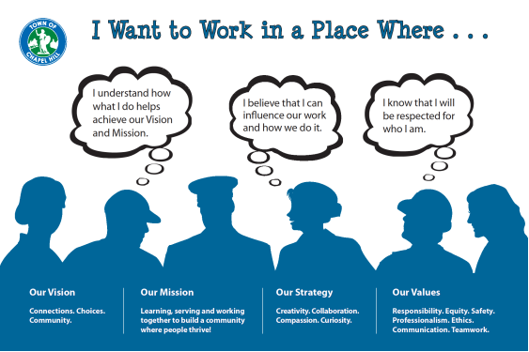

Slide 4
Survey Purpose
Employee views on Town as place to work and how organization values its employees
Improvements since 2013 survey

Slide 5
Design and Process
Employee and management feedback on 2013 survey
Focus on improvements
Employee identity concealed
Surveys returned directly to The MAPS Group
Internet survey (80%) and paper survey (20%)
Employees completed May – June 2015
Promotion efforts

Slide 6
Topic Areas
Employee and the Jo | Teamwork
Employee and the Job Communications | Teamwork Trust
Organizational Changes | Job Satisfaction
Mission and Values | Employee and the Town
Decision Making | Improvements Over Time

Slide 7
Town-wide Results

Slide 8
Participation Demographics
50% participation rate
467 participants out of 928 employees

Slide 9
Participation Demographics (continued)

Slide 10
Participation Demographics (continued)

Slide 11
Participation Demographics (continued)

Slide 13
Employee and the Job

Slide 15
Communications

Slide 16
Top Down Communications
Accurate
77% agree
Timely, Complete, Open, Adequate, Written
53% to 60% agree

Slide 19
Town Organizational Changes

Slide 23
Town Mission and Values

Slide 24
Mission and Values Understanding
Majority agree:
Understand how their job helps achieve the Town Mission - 78%
Understand the RESPECT Values – 76%
Believe their attitude at work impacts the Mission - 90%
View people service as a priority in the work place – 83%

Slide 26
Percentage of Employees Who Agree Consistently See the Values Exhibited in the Workplace
Value | Often and Always | Sometimes, Often, and Always
Safety | 84% | 97%
Professional | 69% | 93%
Ethics | 65% | 91%
Teamwork | 67% | 90%
Communications | 49% | 86%
Responsibility | 44% | 81%
Equity | 44% | 81%

Slide 27
Decision Making in the Workplace

Slide 28
Decision Making in the Employee’s Workplace
I believe that I can influence work and how is work done. 72% agree
I believe I am respected for who I am and for my contributions to organization. 61% agree

Slide 29
Decision Making in the Employee’s Workplace (continued)
My input is sought on how things are done. 52% agree
I understand how the mission influences decision for organizational initiatives and town resources. 49% agree
I believe I can provide input in developing Town rules. 46% agree
I am given opportunity to contribute to decision about workplace. 45% agree
Employees wanting to make their own decision in workplace would be valued. 41% agree

Slide 31
Trust

Slide 32
Trust in the Workplace
Other employees can trust me to do the right thing.
93% agree
You can trust employees to do the right thing.
49% agree

Slide 34
Teamwork

Slide 36
Job Satisfaction

Slide 39
Working for the Town

Slide 42
Improvements Over Time

Slide 43
Employee Agree Improvements Since Last Survey
Teamwork within department 42%
Communications Town-wide 37%
Communications within departments 39%
Employee reflecting Town values 31%
Teamwork across Town 31%
Enjoy working for Town more than 2 years ago 33%

Slide 44
Supervisory/Non-Supervisor
Generally close scores
No significant difference in opinions
Supervisors more familiar with new programs
Supervisors participate more in decision-making processes

Slide 45
Comparisons to 2013 Survey
Significant improvement in top down communications
Significant improvement in employee understanding of mission and values
Scores somewhat lower for likelihood new programs will bring change
Empowerment scores slightly better

Slide 46
Summary Thoughts
Great response rate for a follow up survey; several departments improved participation
Areas rated high
Mission and Values
Teamwork
Job/Town Satisfaction

Slide 47
Summary Thoughts (continued)
Areas of future concentration
Continue to focus on communication efforts
Engage employees early in decision making process
Efforts to improve trust between employee and supervisor
More advancement opportunities noted strongly in comments
Maintain specific topic areas rated high

